Slide 1
Topic 16
Queues
Adapted from Mike Scott’s materials

Slide 2
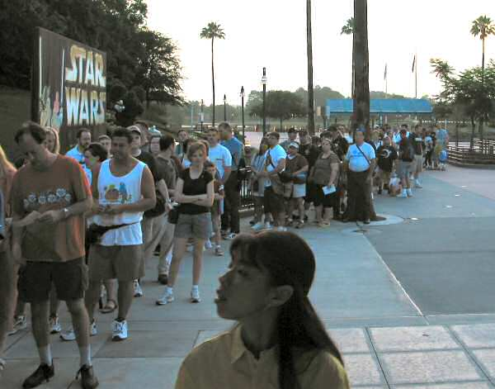
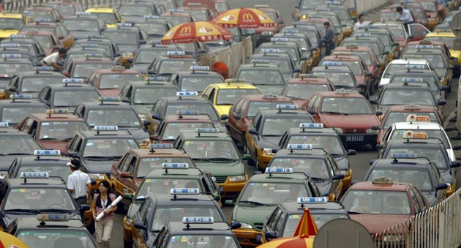
Queues
Like a line
  In England people don’t “get in line”
  they “queue up”.
CS314
Queues

Slide 3
Queue Properties
Queues are a first in first out data structure
  FIFO (or LILO, but that sounds a bit silly)
Add items to the end of the queue
Access and remove from the front
  Access to the element that has been in the structure the longest amount of time
Used extensively in operating systems
  Queues of processes, I/O requests, and much more
CS314
Queues

Slide 4
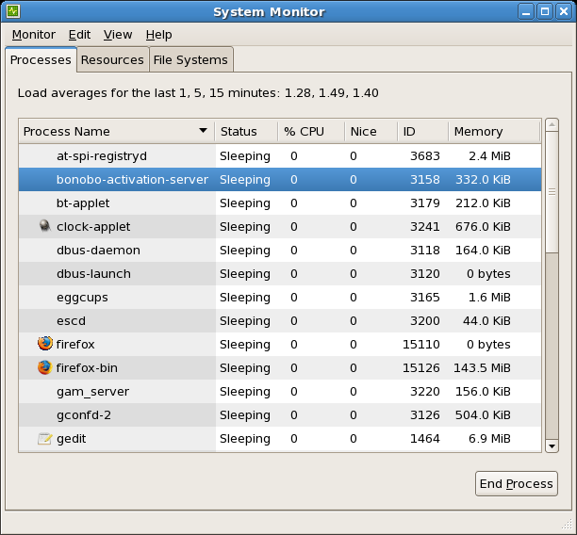
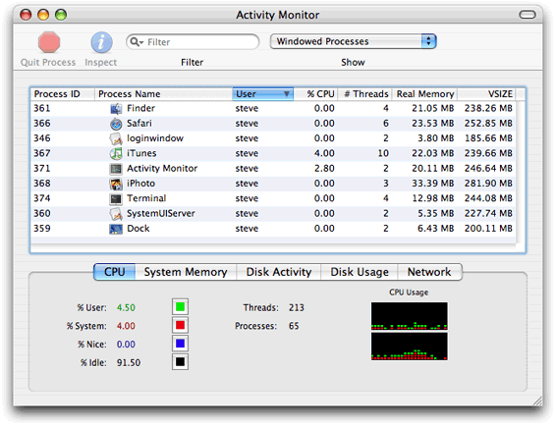
Queues in Operating Systems
On a computer with N cores on the CPU, but more than N processes, how many processes can actually be executing at one time?
One job of OS, schedule the processes for the CPU
CS314
Queues

Slide 5
Queue operations
enqueue(E item)
  a.k.a. add(E item)
E front()
  a.k.a. E peek()
E dequeue()
  a.k.a. E remove()
boolean isEmpty()
Specify methods in an interface, allow multiple implementations.
CS314
Queues

Slide 6
Queue interface, version 1
public interface Queue<E> {
//place item at back of this Queue
enqueue(E item);
//access item at front of this Queue
//pre: !isEmpty()
E front();
//remove item at front of this Queue
//pre: !isEmpty()
E dequeue();
boolean isEmpty();
}
CS314
Queues

Slide 7
Implementing a Queue
Given the internal storage container and choice for front and back of queue what are the Big O of the queue operations?
Array LinkedList
(Singly Linked)
enqueue
front
dequeue
isEmpty
CS314
Queues

Slide 8
Question
If implementing a queue with a singly linked list with references to the first and last nodes (head and tail) which end of the list should be the front of the queue in order to have all queue operations O(1)?
The front of the list should be the front of the queue
The back of the list should be the front of the queue.
Either end will work to make all ops O(1)
Neither end will allow all ops to be O(1)
CS314
Queues

